Slide 1



Cooperative Adaptive Cruise Control
Team 3
Ishita Pal - 5G Transmitter
Neethu Jose - 5G Receiver
Sung-Lin Chen – Radar Receiver
Yi-Chien Chiang – Radar Transmitter

Slide 2
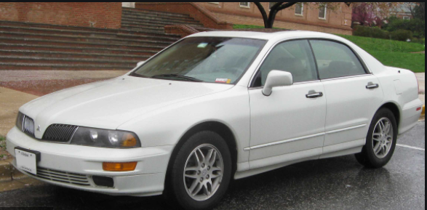
System Overview
ACC (Adaptive Cruise Control)
Allows vehicles to speed up and slow down automatically in order to keep pace with the traffic ahead using radar
Breakthrough technology in vehicle safety system
In 1995, Mitsubishi was the first OEM to offer ACC in their Diamante sedan
CACC (Cooperative Adaptive Cruise Control)
Evolution of ACC
Using 5G to achieve vehicle-to-vehicle (V2V) communication
CACC equipped vehicle can interact with more vehicles and surrounding environment

Slide 3


System block diagram
Radar Control System
Vehicle
V2V - 5G
Radar Transceiver
5G communication link
Host vehicle
Radar
Preceding vehicle
Target Vehicle In Front

Slide 4
Top Level Specs
5G Comm.
- Frequency (15GHz)
- Range ( ~ 1000m)
- Antenna Tx and Rx (Horn Antenna)
ACC Radar
- Frequency (77GHz)
- Range ( ~ 80m)
- Antenna Tx and Rx (E-Band Lens Array Antenna )

Slide 5
Transmitter and Receiver Block Diagram- Radar
Antenna
Mixer
F_{IF} =1 GHz
IF
LPF
BPF
DA
PA
F_{RF} =77 GHz
F_{LO} =76 GHz
Oscillator
F_{IF} =1 GHz
F_{LO} =76 GHz
IF
LNA
LPF
BPF
LNA
BPF
Mixer

Slide 6
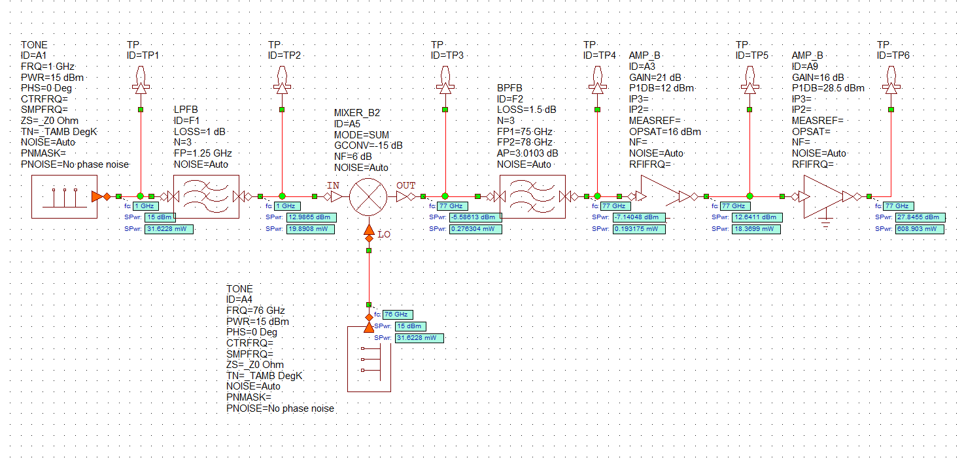
Radar Transmitter
IFin = 1GHz
LO = 76GHz
F_{RF} = 77GHz

Slide 7

Radar TX Calculation
Pin = 15dBm = 31.62mW
Pout = 28.04dBm = 636.76mW
Pdc = 1500mw + 6750mw + 4125mw = 12375mW
PAE(%) = 4.9%
Gt = 20dBi
EIRP = Pt + Gt = 28.04dBm + 20dBi = 48.04dBm
MDS = N$0$ = KTB = -113.86dBm = 4.1*10⁻⁹ mW
fo = 77GHz
𝜎 = 1m²
𝜆 = 0.0392m
$R_{max}$ =${[ \frac{Pt G2 λ σ}{Pmin \left(4π\right)3 } ] }^{\frac{1}{4}}$ = 76.8m
FSPL = $\frac{{(4πR_{max})}^{2}}{λ^{2} }$ = 107.87dB

Slide 8
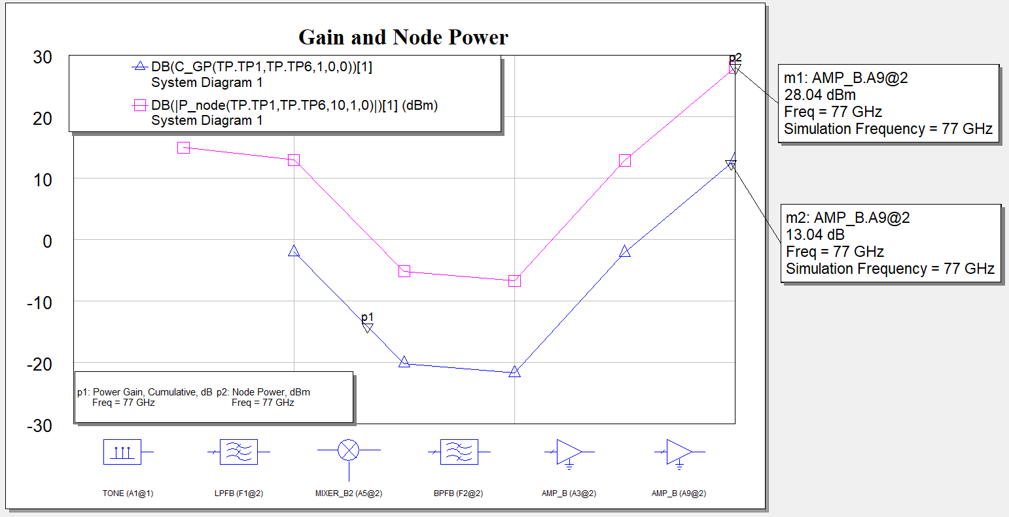
Radar TX Gain and Node Power

Slide 9
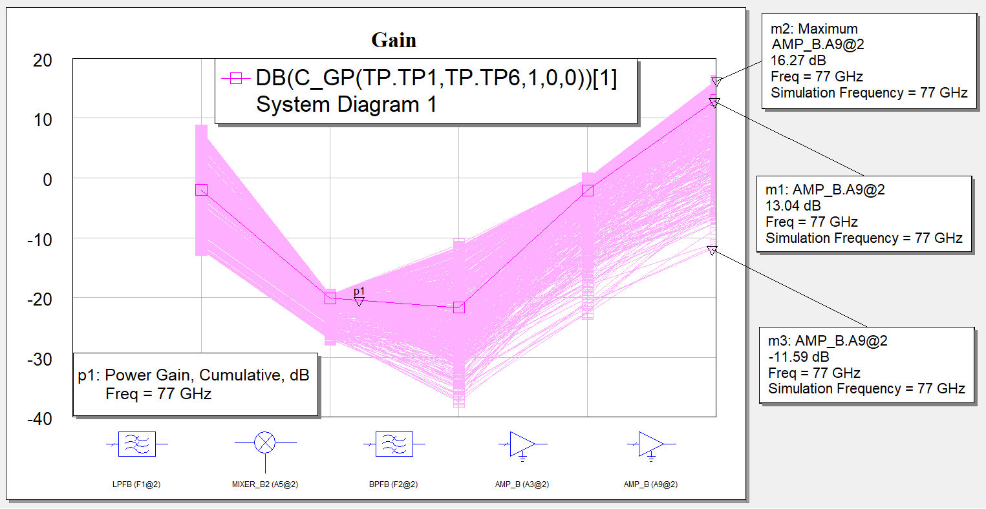
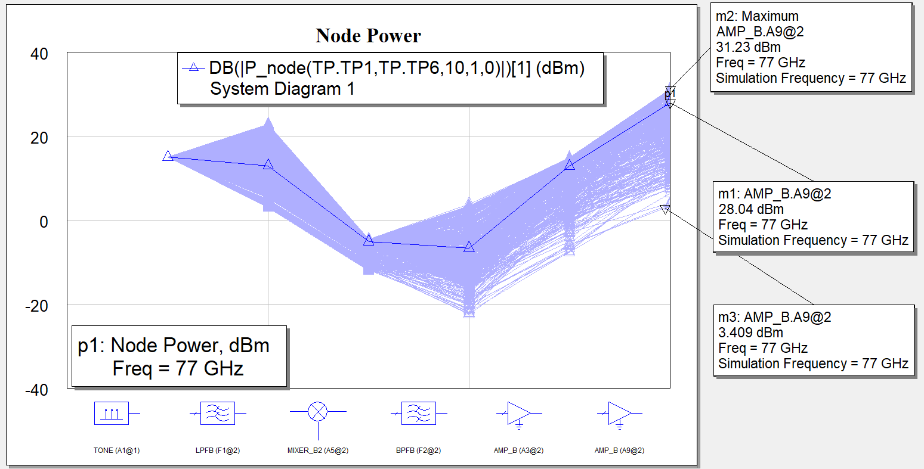
Radar TX Gain and Node Power Yield Simulation

Slide 10
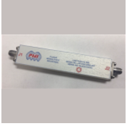
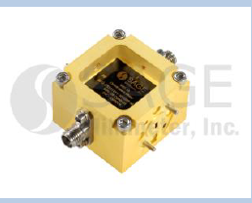
Low Pass Filter -LPF1R25-22R5-SFF
MIXER - SFQ-75311415-1010SF-N1-M
Parameter | Min. | Typ. | Max.
RF Frequency | 75GHz |  | 108GHz
LO Frequency | 75GHz |  | 108GHz
IF Frequency | 0GHz |  | 20GHz
LO Power |  | 15dBm | 20dBm
Conversion Loss |  | 15dB
Parameter | Value
Model | LPF1R25-22R5-SFF
Frequency Range | 0 –1.25 GHz
Insertion Loss | 1-1.5 dB

Slide 11
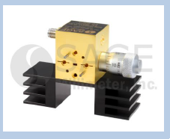
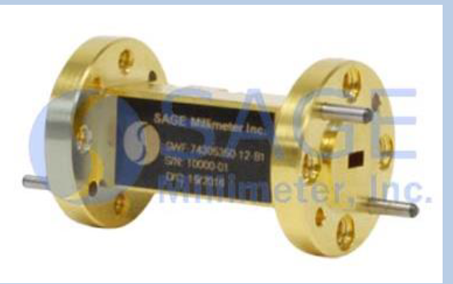
Local Oscillator - SOM-77302315-12-M1
BandPass Filter - SWF-77303350-12-B1
Parameter | Value
Model | SOM-77302315-12-M1
Frequency Range | 75.5GHz – 77.5GHz
Power Output | 15dBm
Bias Voltage | +5.5 VDC
Bias Current | 750 mA
Operating Temperature | 0 - 50˚C
Parameter | Min. | Typ. | Max.
Passband Frequency | 75GHz |  | 78GHz
Passband Insertion Loss |  | 1.5dB
Passband Ripple |  | ±0.3 dB
Operating Temperature | -40˚C |  | +85˚C

Slide 12
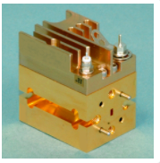
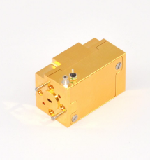
Driver Amplifier - AMP-12-02310
Power Amplifier - FPA-12-0001
Parameter | Value
Model | AMP-12-02310
Frequency Range | 75 – 87 GHz
Gain | 16-21 dB
P1dB | 12dBm
PDC | 1.5 W
Parameter | Value
Model | FPA-12-0001
Frequency Range | 71 – 77 GHz
Gain | 16 dB
P1dB | 28.5dBm
PDC | 6.75W

Slide 13
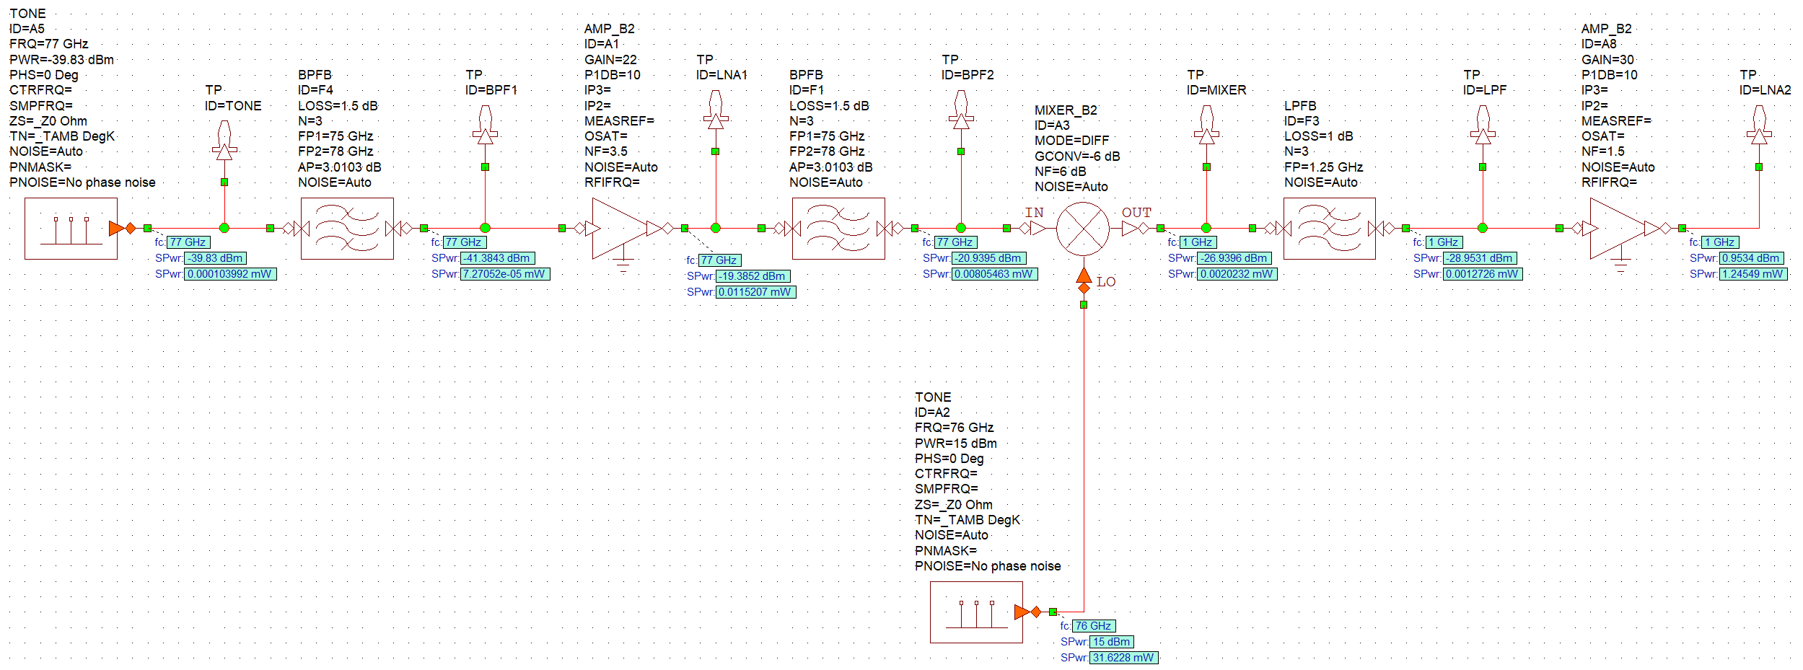
Radar Receiver
RF Frequency: 77GHZ
Received Power: -39.83dBm
LO Frequency: 76GHz
IF Frequency: 1 GHz

Slide 14

Radar RX Calculation
$f_{0}$=77GHz ; $MDS=kTB=−113.86dBm$ ; $λ=0.0039m$ ; $RCS={1m}^{2}$
$FSPL$= $\frac{{(4πR_{max})}^{2}}{λ^{2} }$ = 107.87dB
$P_{r}=P_{t}+G_{t}+G_{r}−FSPL=−39.83dBm>MDS=−113.86dBm$

Slide 15
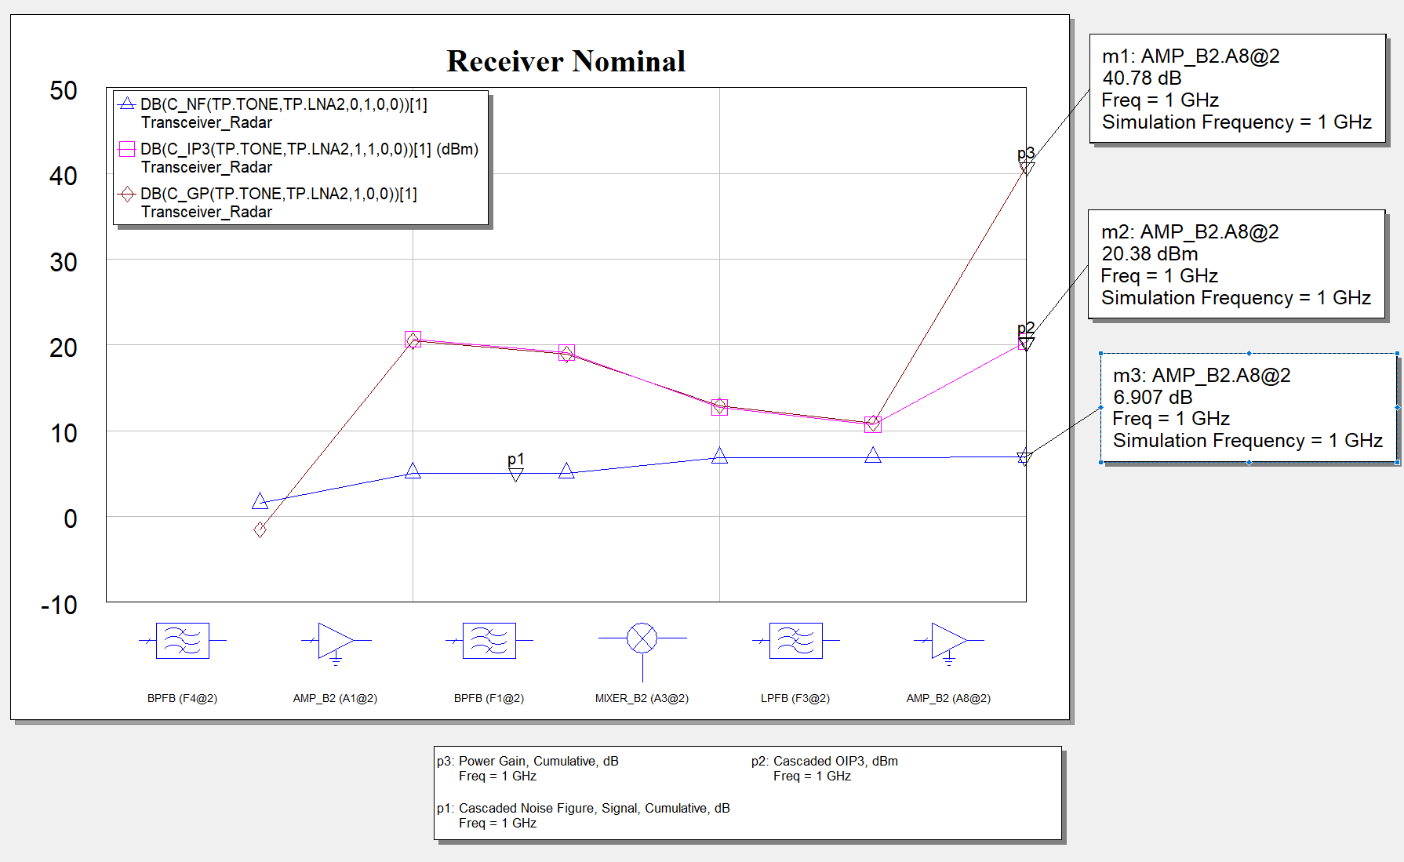
Radar RX Nominal

Slide 16
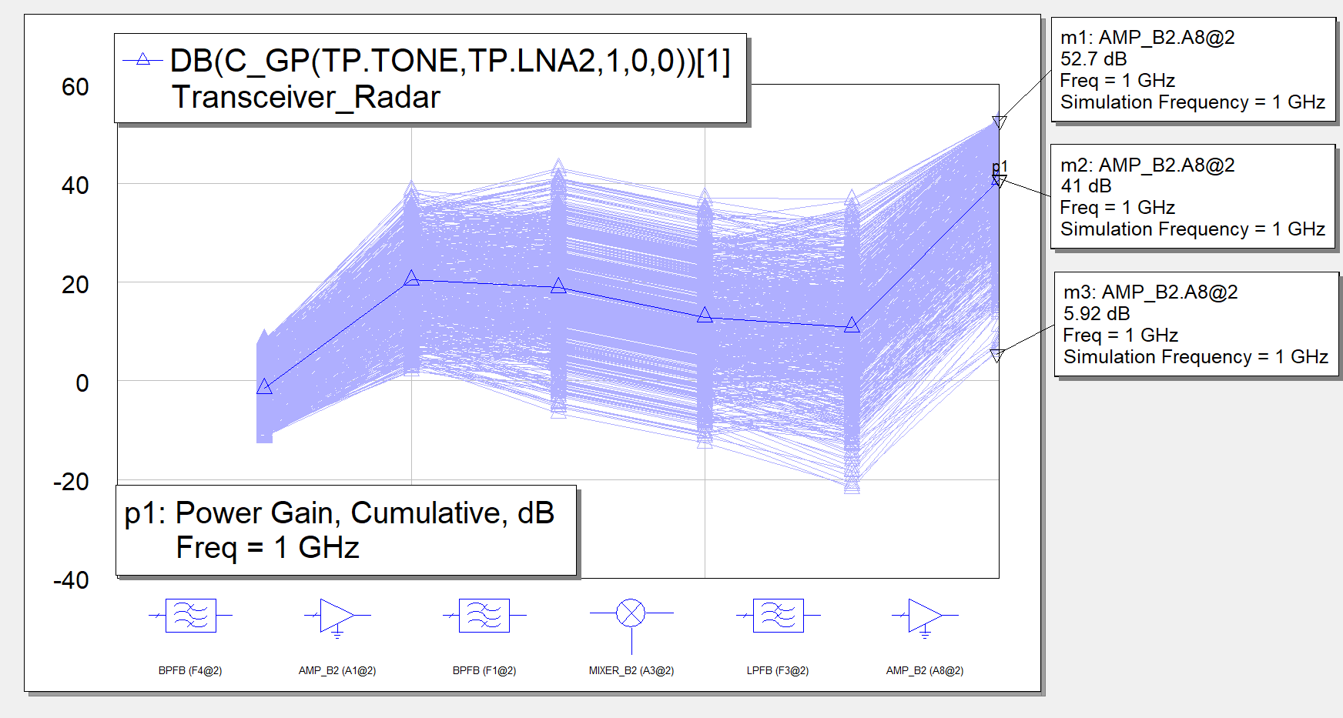
Radar RX Yield Analysis: Gain

Slide 17
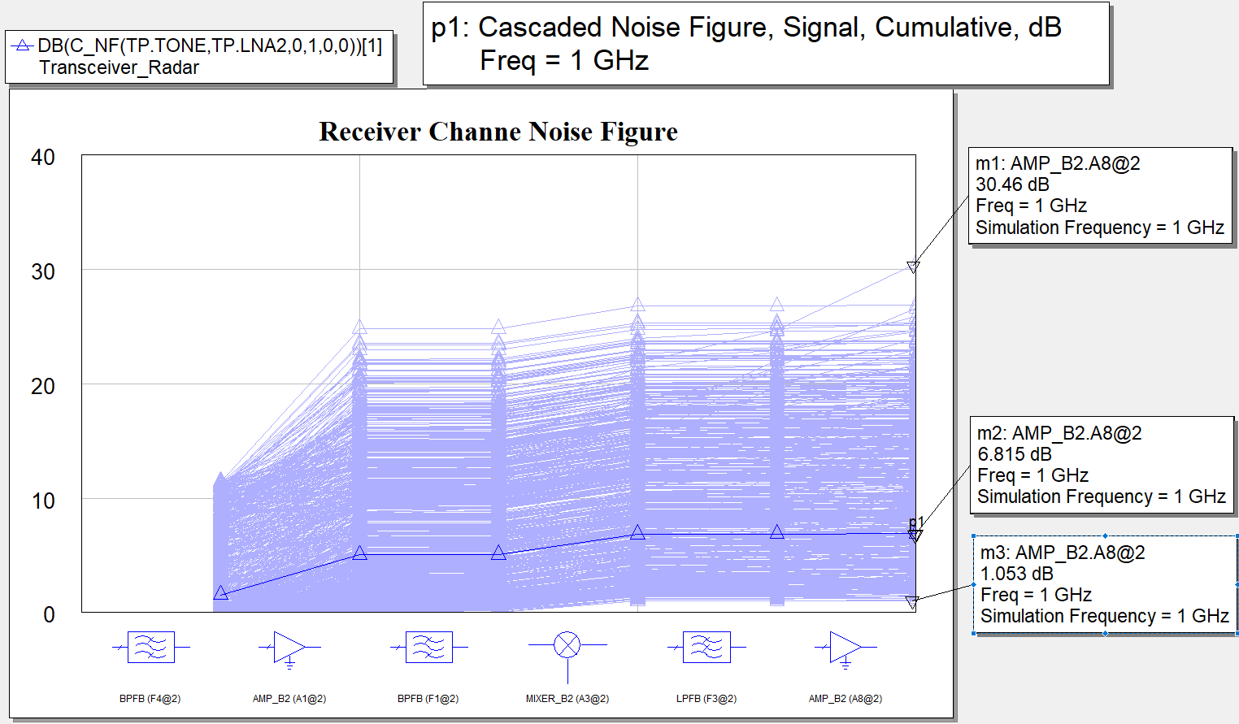
Radar RX Yield Analysis: Noise Figure

Slide 18
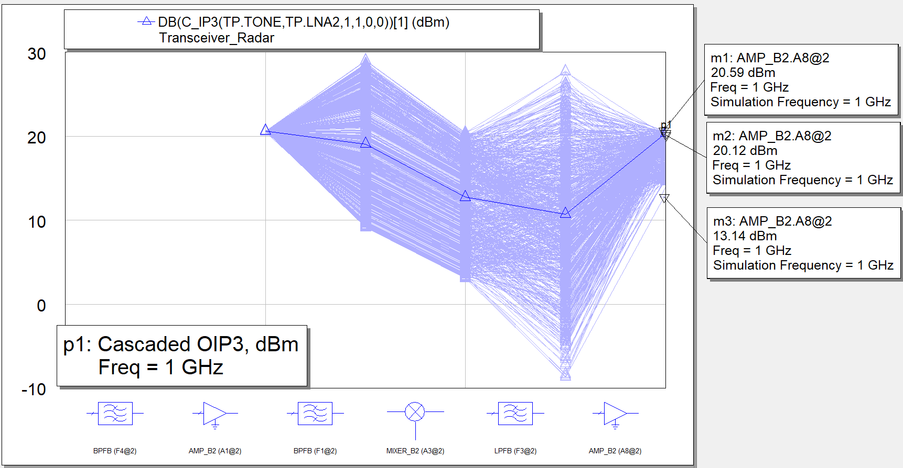
Radar RX Yield Analysis: IP3

Slide 19
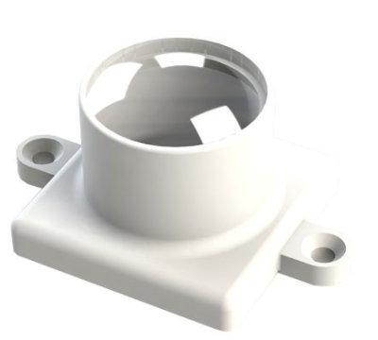
Antenna - ELA100.A
Parameter | Value
Frequency Range | 77GHz
Gain | 20dB
Beamwidth | 20°
Bandwidth | 1GHz

Slide 20
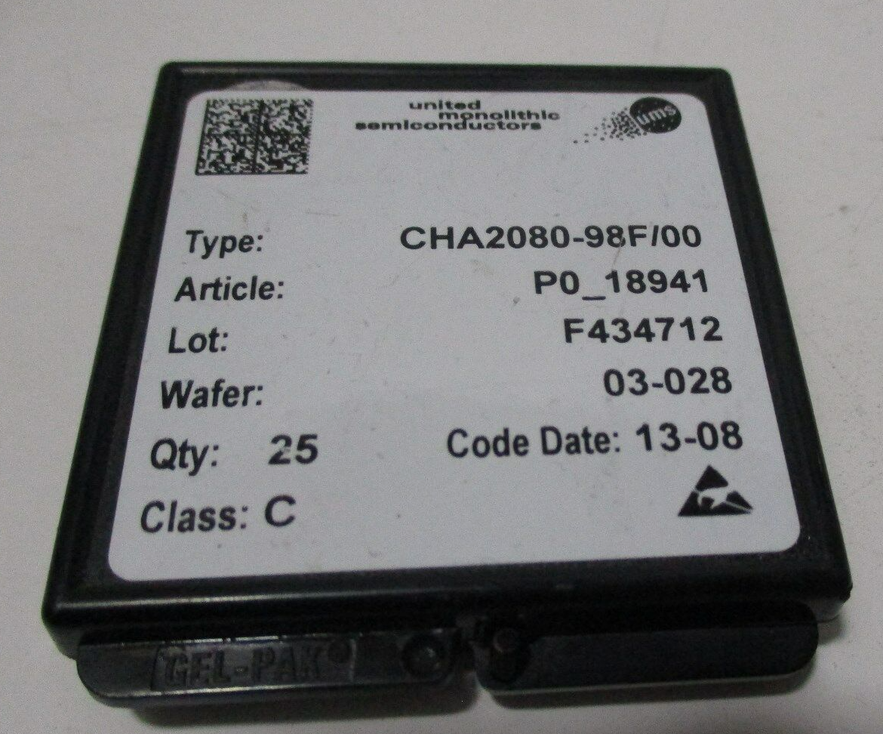
BandPass Filter - SWF-77303350-12-B1
Low Noise Amplifier 1: CHA2080-98F
Parameter | Min. | Typ. | Max.
Passband Frequency | 75GHz |  | 78GHz
Passband Insertion Loss |  | 1.5dB
Passband Ripple |  | ±0.3 dB
Operating Temperature | -40˚C |  | +85˚C
Parameter | Value
Manufacture | United Monolithic Semiconductors
Model | CHA2080-98F
Frequency Range | 71 – 86 GHz
Gain | 22 dB
P1dB | 10dBm
Noise Figure | 3.5dB
PDC | 262.5mW

Slide 21
Local Oscillator - SOM-77302315-12-M1
MIXER - SFQ-75311415-1010SF-N1-M
Parameter | Value
Model | SOM-77302315-12-M1
Frequency Range | 75.5GHz – 77.5GHz
Power Output | 15dBm
Bias Voltage | +5.5 VDC
Bias Current | 750 mA
Operating Temperature | 0 - 50˚C
Parameter | Min. | Typ. | Max.
RF Frequency | 75GHz |  | 108GHz
LO Frequency | 75GHz |  | 108GHz
IF Frequency | 0GHz |  | 20GHz
LO Power |  | 15dBm | 20dBm
Conversion Loss |  | 15dB

Slide 22
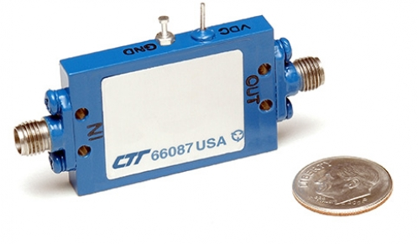
Low Pass Filter -LPF1R25-22R5-SFF
Low Noise Amplifier 2: ABX/00102-1530
Parameter | Value
Manufacturer | CTT Inc.
Model | ABX/00102-1530
Frequency Range | 0.1GHz-20GHz
Gain | 30dB
P1dB | 10dBm
Noise Figure | 1.5dB
PDC | 1600mW
Parameter | Value
Model | LPF1R25-22R5-SFF
Frequency Range | 0 –1.25 GHz
Insertion Loss | 1-1.5 dB

Slide 23
Transmitter and Receiver Block Diagram- 5G
Antenna
Transmitter Block Diagram
Receiver Block Diagram
Mixer
IF INPUT
LNA
BPF
PA
PA
F_{IF} =1 GHz
F_{RF} =15 GHz
LO
F_{LO} =14 GHz
Antenna
Mixer
IF output
LNA
BPF
LPF
IFA
IFA
F_{RF} =15 GHz
F_{IF} =1 GHz
LO
F_{LO} =14 GHz

Slide 24
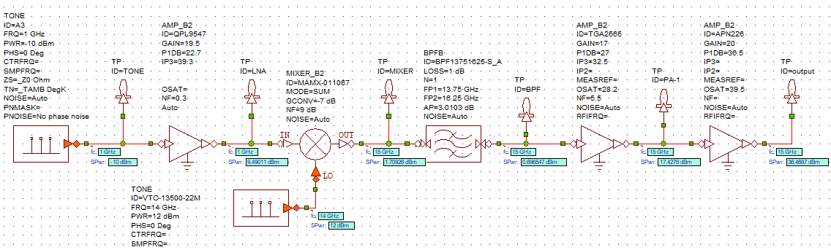
5G Communication Transmitter
IF Freq= 1 GHz
LO Freq = 14 GHz
RF Freq = 15 GHz

Slide 25
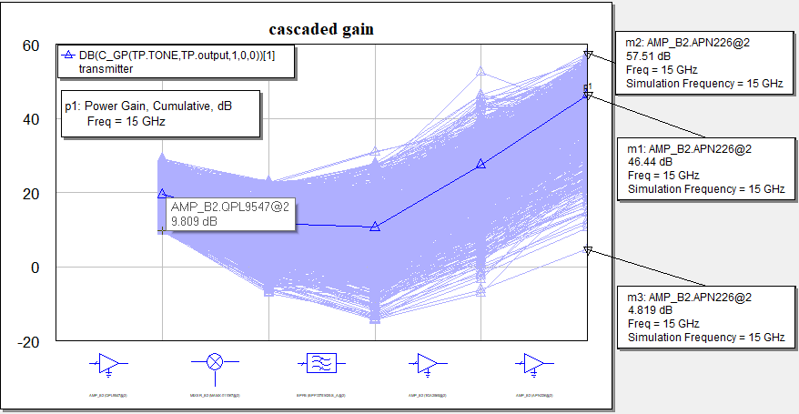
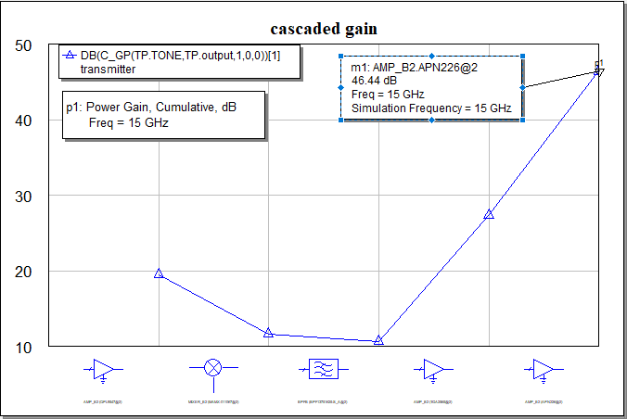
5G Comm. TX - Cascaded Gain Graph
Nominal Cascaded Gain (G) = 46.44 dB

Slide 26
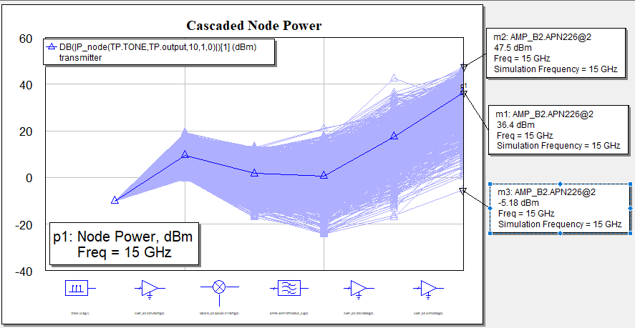
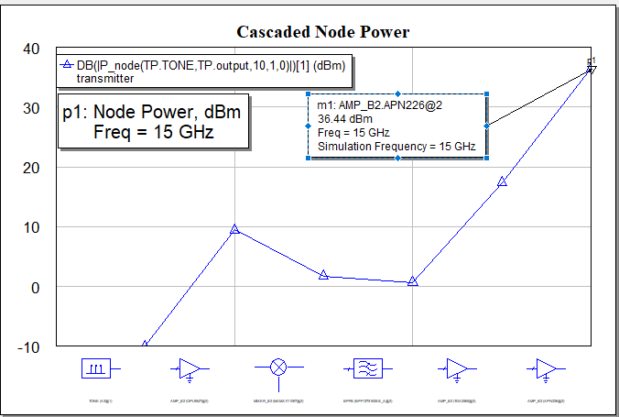
5g comm. Tx – cascaded node power
Nominal Cascaded Power (Pt) = 36.44 dBm

Slide 27
5G TX Calculation
P_{in =} -10 dBm = 0.1 mW
P_{out =} 36.44dBm = 4415.70 mW
P_{dc =} (5*65)+(6*210)+(24*240) = 7345 mW
PAE_{total} = (P_{out} - P_{in})*100/ P_{dc} = 60.11%
P_{t} = 36.44 dBmW = 6.44 dBW = 4.405W
G_{t} = G_{r} = 20 dB = 100
EIRP = P_{t} + G_{t} = 56.44 dBm = 26.44 dB = 440.55W
f = 15 GHz λ = c/f = 0.02
P_{r} = -39.5 dBmW = -69.5 dBW= 112.2 nW
R = √( P_{t} *G_{t}* G_{t}* λ² )/( P_{r} *(4*π)²) = 999.59 m

Slide 28

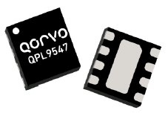
LNA - QPL9547
Parameters | Values
Frequency | 0.1-6 GHz
Gain | 19.5 dB
OIP3 | 39 dBm
P1dB | 22.7 dBm
Noise Figure | 0.3 dB
Current | 65 mA
Supply Voltage | 5 V

Slide 29
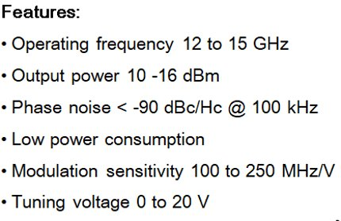
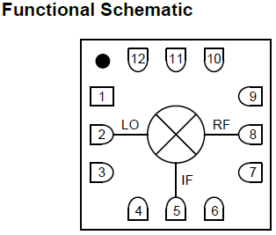

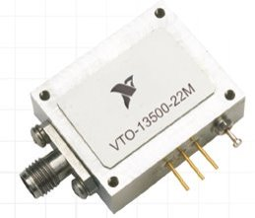

Mixer - MAMX-011067
Local oscillator - VTO-13500-22M
Parameter | Units | Min. | Typ. | Max.
LO and RF Frequency | GHz | 5 |  | 20
IF Frequency | GHz | 0 |  | 6
LO Power | dBm |  | 15
Conversion Loss | dB |  | 7 | 9
Input P1dB | dBm |  | 8
Input IP3 | dBm |  | 18

Slide 30
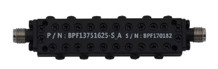
Bandpass filter - BPF13751625-S_A
Parameters | Values
Frequency | 13.75-16.25 GHz
Impedance | 50 Ω
Center Frequency | 15 GHz
Insertion loss | 1 dB
Ripple | 1 dB
Return Loss | 14 dB

Slide 31
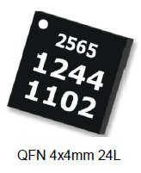

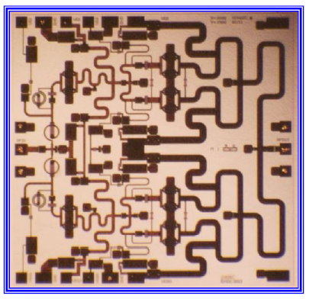

Power amplifier 1 TGA2565-SM
Power amplifier APN226
Parameters | Values
Frequency | 11- 17 GHz
Gain | 27 dB
OIP3 | 34 dBm
P1dB | 27 dBm
Psat | 28.2 dBm
Current | 210 mA
Supply Voltage | 6 V
Noise Figure | 5.5 dB
Parameters | Values
Frequency | 13.5-15.5 GHz
Gain | 20 dB
Psat | 39.5 dBm
P1dB | 36.5 dBm
Output Return loss | 12 dB
Current | 240 mA
Supply Voltage | 24 V
GaN Power Amplifier

Slide 32
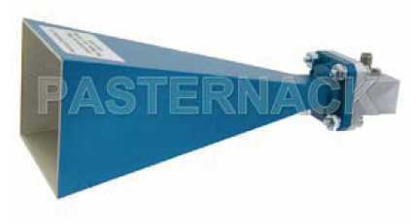
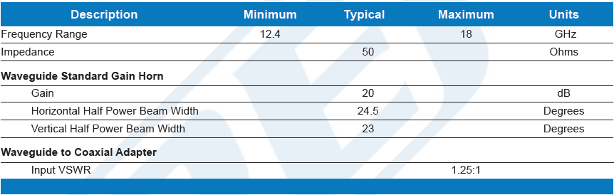
Antenna - pe9854/sf-20

Slide 33
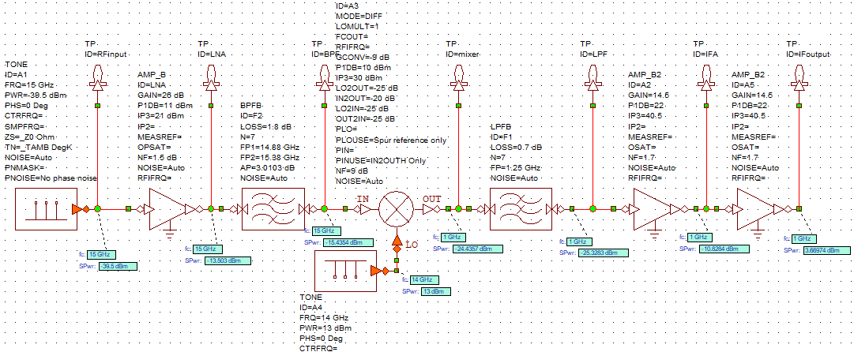
5G Communication Receiver
F_{RF} =15 GHz
P_{r} =-39.5 dBm
F_{LO} =14 GHz
F_{IF} =1 GHz

Slide 34
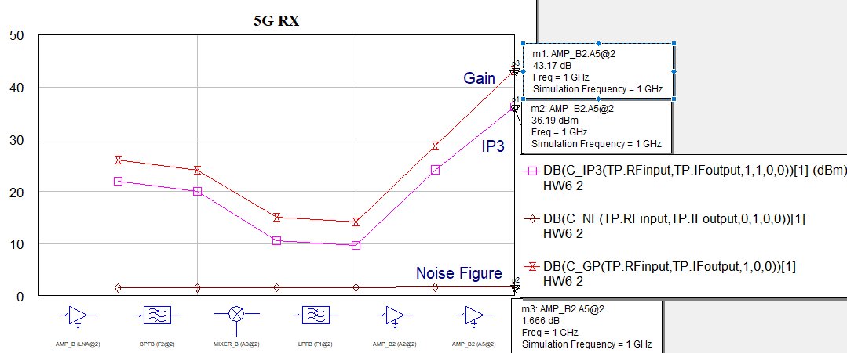
5G Receive Channel Simulation
Cascaded NF = 1.66 dB
Cascaded Gain = 43.17 dB
Cascaded IP3= 36.19 dBm

Slide 35
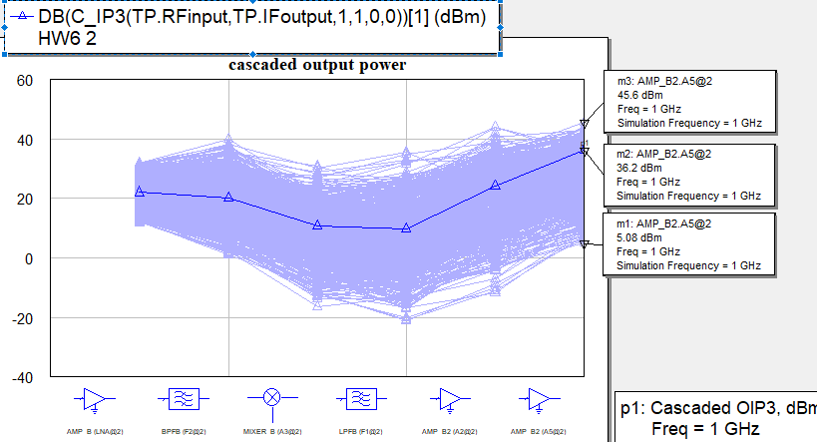
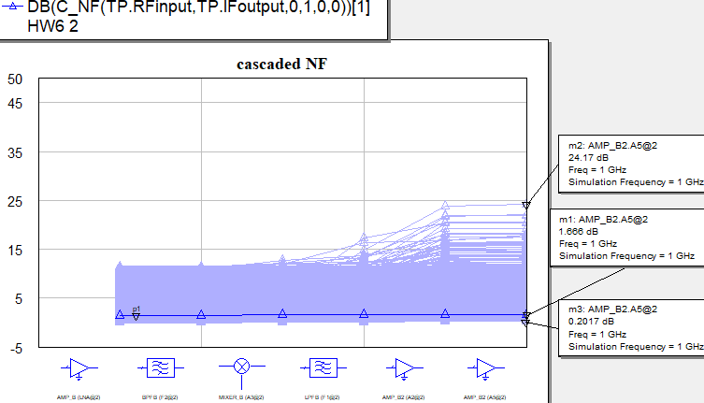
YIELD analysis- IP3 & NF

Slide 36
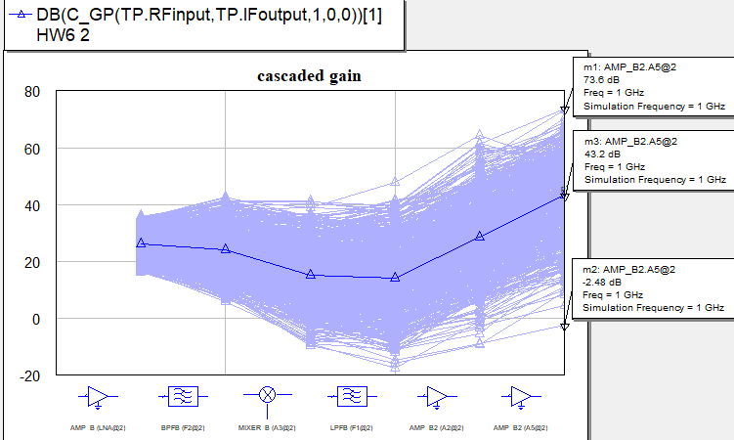
YIELD analysis- GAIN

Slide 37
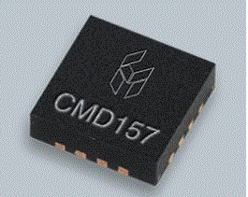
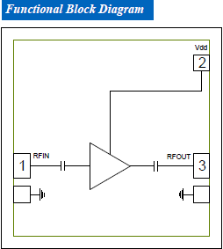
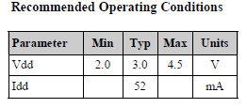
LNA - CMD157
Parameter | Value
Manufacturer | Custom MMIC
Model | CMD157
Frequency Range | 6-18 GHz
Gain | 26 GHz
Noise Figure | 1.5 dB
Output P1dB | 11 dBm
OIP3 | 22 dBm

Slide 38
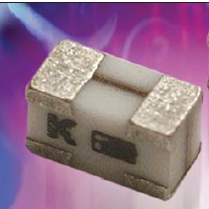
Lowpass filter - LP0805H1250ASTR
Parameter | Value
Manufacturer | AVX RF
Model | LP0805H1250ASTR
Frequency Range | 0 –1.25 GHz
Insertion Loss | 0.7 dB
IMAGE Reject filter - B0315G12
Parameter | Value
Manufacturer | Microwave Circuits
Model | B0315G12
Passband Frequency Range | 14.88 - 15.38 GHz
Passband Insertion Loss | < 1.8 dB
Bandwidth @ 3dB | 400 MHz

Slide 39
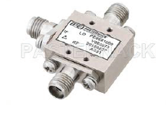
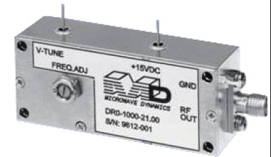
Mixer & LO
Parameter | Value
Manufacturer | Pasternack
Model | PE86X1009
LO and RF Frequency | 7-43 GHz
IF Frequency | 0-10 GHz
LO Power | 13 dBm
Conversion Loss | 9 dB
Parameter | Value
Manufacturer | Microwave Dynamics
Model | DRO-1000
Frequency | 1-50 GHz
LO Power | 13 dBm
DC Power | 10V*90mA = 0.9W

Slide 40
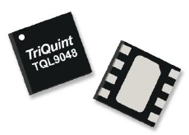
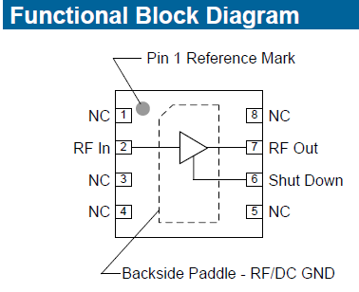

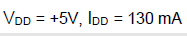
IF Amplifier - TQL9048
Parameter | Value
Manufacturer | TriQuint
Model | TQL9048
Frequency Range | 0.05 -4 GHz
Gain | 14.5 GHz
Noise Figure | 1.7 dB
Output P1dB | 22 dBm
OIP3 | 40.5 dBm

Slide 41
5g Receiver Calculation
P_{t} = 36.46 dBmW
G_{t} = 20dB
f = 15 GHz
λ = c/f = 0.02
FSPL = (4*π*R)² / λ² =3.94 x 10¹¹ → 115.96 dB
𝑃_{𝑟}=𝑃_{𝑡}+𝐺_{𝑡}+𝐺_{𝑟}−𝐹𝑆𝑃𝐿 = 36.46 + 20 + 20 - 115.96 = -39.5 dBm
𝑀𝐷𝑆=𝑁₀=𝑘𝑇𝐵=𝑘 (151.85 𝐾)(1.25 G𝐻𝑧) → -85.817 dBm

Slide 42
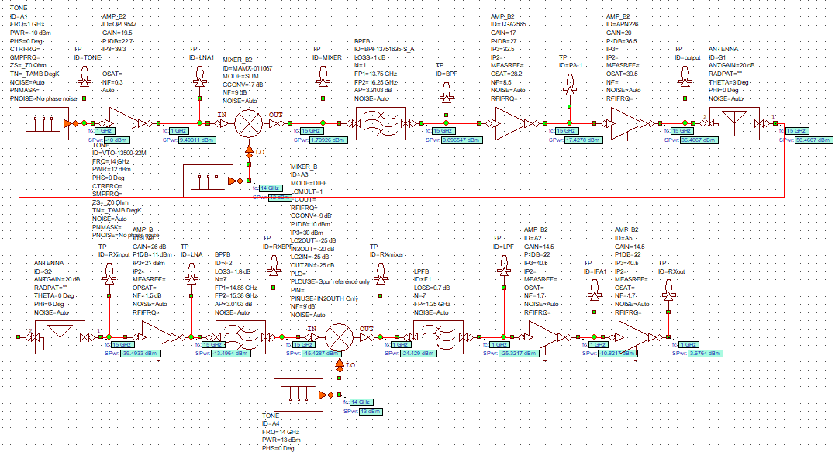
5G Tx & Rx Channel

Slide 43
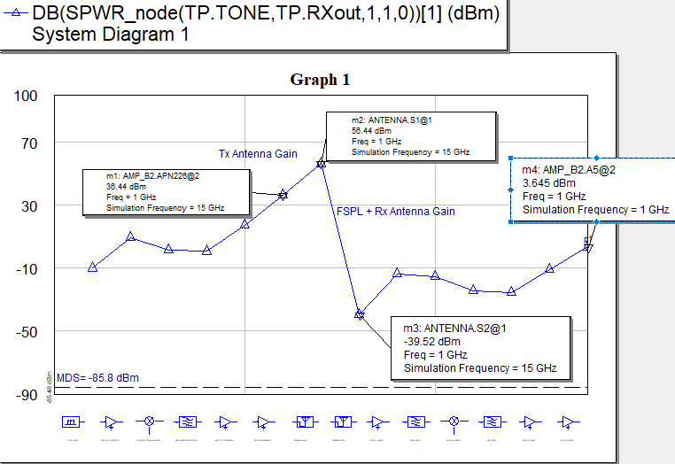
5G Tx & Rx Channel
FSPL= -115.96dB
Antenna Gain = 20 dB

Slide 44
5G Comm Link Spec Compliance Matrix
Parameter | Initial Spec | Reason for Changing Spec | Min/Max | Simulated Performance | Compliant (Y/N)
Frequency Band (GHz) | 14.5 - 15.5 |  | Min | 15 | Y
Transmit Output Power (dBm) | 33 |  | Min | 36.44 | Y
Transmit Channel Gain (dB) | 30 | To achieve Pt atleast 33 dbm | Min | 46.17 | Y
Transmit Channel PAE (%) | 50 |  | Min | 60.11 | Y
Receive Noise Figure (dB) | 2 |  | Max | 1.66 | Y
Receive Channel Gain (dB) | 25 | To achieve Pout nearly 0 dbm | Min | 46.44 | Y
Receiver Channel OIP3 (dBm) | 25 | To achieve Pout nearly 0 dbm | Min | 36.19 | Y
TX Antenna Az Beamwidth (degrees) | +/- 60 |  | Max | 24.5 | Y
RX Antenna Az Beamwidth (degrees) | +/- 60 |  | Max | 24.5 | Y
Range (m) | 1000 |  | Min | 999.59 | N
Total DC Power Consumption (W) | 5 | DC power consumption is larger than expected | Max | 7.72+2.35=10.07 | N

Slide 45
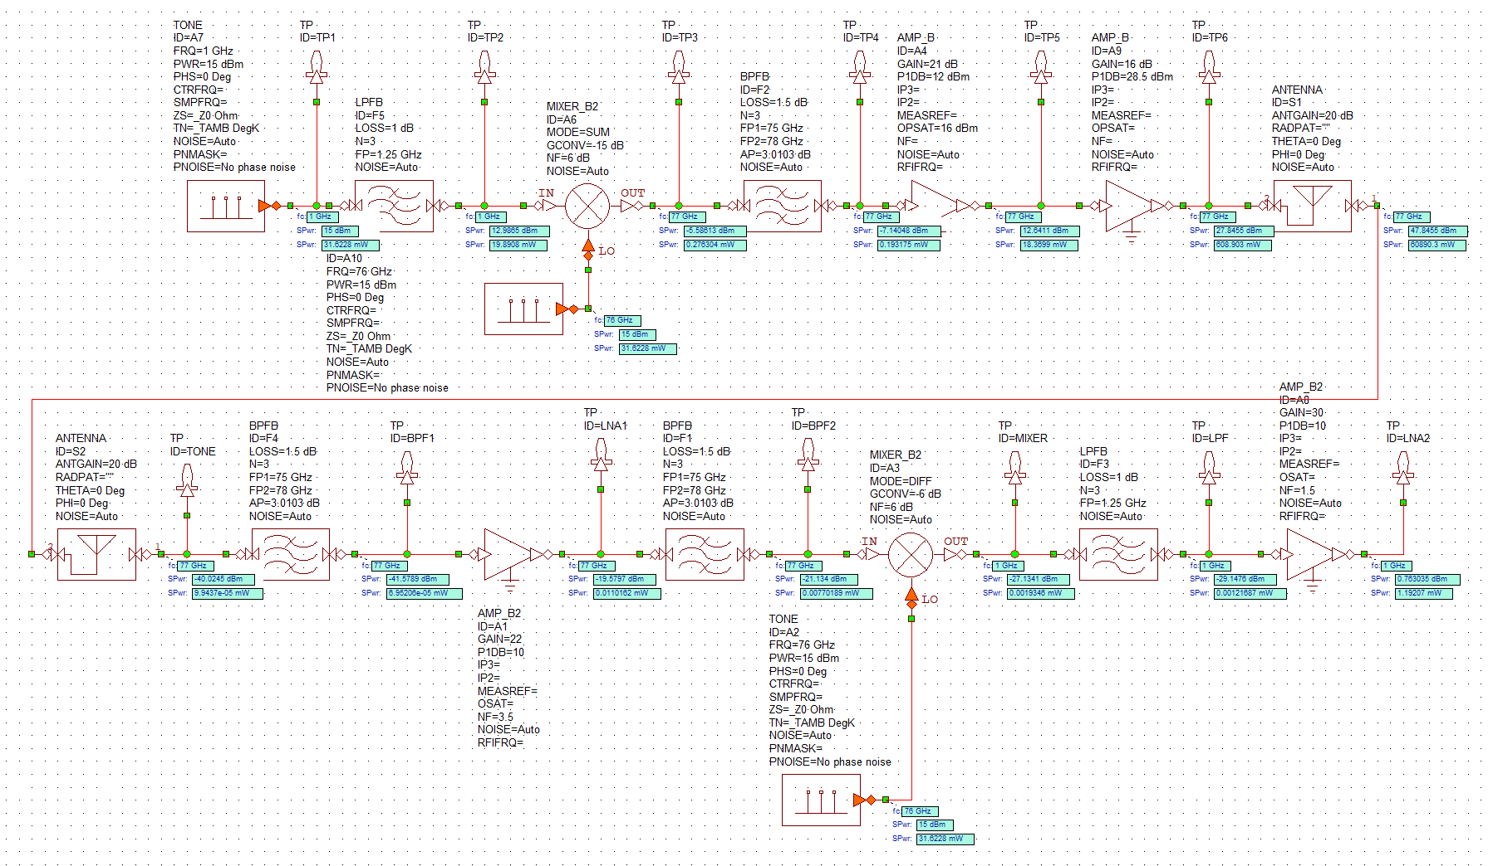
Radar TX And RX Channel

Slide 46

Radar TX And RX Graph

Slide 47
Top-level Compliance Matrix: Radar
Parameter | Original Spec | Min/Max | Simulated Performance | Compliant (Y/N)
Frequency Band (GHz) | 76 – 77 | Min | (77) 76.5-77.5 | N
Transmit Output Power (dBm) | 33 | Min | 28.04 | N
Transmit Channel Gain (dB) | 27 | Min | 13.04 | N
Transmit Channel PAE (%) | 30 | Min | 4.9% | N
Receive Noise Figure (dB) | 3 | Max | 6.9 | N
Receive Channel Gain (dB) | 20 | Min | 40.78 | Y
Receiver Channel OIP3 (dBm) | 23 | Min | 20.38 | N
Antenna Beamwidth (degrees) | +/- 3 | Max | 20 | N
Range (m) with Target RCS=1.0m^2 | 100 | Min | 78.4 | N
Total DC Power Consumption (W) | 2.5 | Max | 12.37 +4.71=17.08 | N

Slide 48
DC Power Calculation
DC source : Lead-Acid Battery from the Vehicle
𝑃_{𝐷𝐶,5G𝑅𝑋} = 𝑃_{𝐷𝐶,𝐿𝑁𝐴}+2(𝑃_{𝐷𝐶,𝐼𝐹𝐴𝑚𝑝})+𝑃_{𝐷𝐶,𝐿𝑂} = (3V*52mA) + 2(5V*130mA) + (10V*90mA) = 2.35W
𝑃_{𝐷𝐶,5GTX} = P_{DC,LNA} + P_{DC,PA1}+ P_{DC,PA2}+ P_{DC,LO} = (5V*65mA)+(6V*210mA)+(24V*240mA)+(5V*75mA) = 7.720W
𝑃_{𝐷𝐶,Radar𝑅𝑋} = 𝑃_{𝐷𝐶, LNA1}+𝑃_{𝐷𝐶, LNA2} + 𝑃_{𝐷𝐶,𝐿𝑂} = 262.5mw + 1600mw + 4125mw =5.987W
𝑃_{𝐷𝐶,RadarTX} = 𝑃_{𝐷𝐶, 𝐷𝐴}+𝑃_{𝐷𝐶, P𝐴} + 𝑃_{𝐷𝐶,𝐿𝑂} = 1500mw + 6750mw + 4125mw =12.375W

Slide 49


Environmental, Performance, & Consumer Issues
A CACC system may not work properly in certain weather conditions like heavy rain or fog where 5G signal can be severely interfere.
The gap between the CACC vehicle may be short enough to deter most cut-in lane changes in multi-lane highway environment.
Security attacks like manipulating speed limit, Denial of Service (DoS) attacks on the engine, unauthorized brake, and attacks on active brake function, threaten the safety of passengers.

Slide 50
Meeting standards for Human Exposure for RF signal
Maximum power density for human exposure to RF and microwave electromagnetic fields is 10mW/cm²
For 5G
Power Density=(P_{t}* G_{t})/(4π*D²)=10mW/cm²
D = [(4.425*100)/(4π*100)]^{0.5}= 0.59m
For Radar
Power Density=(P_{t}* G_{t})/(4πD²)=10mW/cm²
D = [(0.563*100)/(4π*100)] ^{0.5} =0.21 m
** We can provide a shield to reduce the human exposure to RF signals generated by the system.

Slide 51
Manufacturing and Test issues
There isn’t one uniform system in place across all car makers and models, so drivers may need to learn a new car’s CACC system each time.
The improvement of traffic efficiency largely depends on the level of CACC deployment.
Testing for abnormal circumstances on the road, for instance, sudden car accident, goods dropped from front vehicle.

Slide 52
Schedule
Task Name | Completion Date
DESIGN
Problem Description | September 2020
Top Level Specifications | November 2020
DEVELOPMENT
Prototype Design | January 2021
Prototype Construction | April 2021
Testing & Integration | June 2021
Debugging | September 2021
Final Testing | December 2021
PRODUCTION
Final Design Submission | July 2022
Complete Bill of Material | September 2022
Product Release | December 2022

Slide 53
Summary
Cooperative Adaptive Cruise Control (CACC)
Using 5G to achieve vehicle-to-vehicle (V2V) communication
CACC equipped vehicle can interact with more vehicles and surrounding environment
Helps in stability of traffic flow & safety of the drivers.

Slide 54
V2V - 5G
Radar
Host vehicle
Preceding vehicle

